Slide 1
MONROE Update
Berlin, July 2016

Slide 2
MONROE Status and Timeline
Started March 1st 2015 (will run 3 years)
Prototype implementation is ready (March 2016)
Node deployment is under way (September 2016)
User feedback on the platform due September 2016
Testbed final implementation is complete and platform open to all users in March 2017

Slide 3
The MONROE system
Scheduling DB
(quotas, current sched, past sched.)
User Access and Scheduling System
Management and Maintenance
MONROE Measurement Responder
NODE
Core Components
MONROE Experiments
mPlane
External User’s
Experiments
REMOTE
REPOSITORY
MONROE
MPLANE
EXTERNAL
DATA IMPORTER
MPLANE REPOSITORY
USERS’ STORAGE
Inventory DB
for
Maintenance and Operations
MONROE
VISUALIZATION
MONROEDB
mPlane Visualisation
OPEN DATA
OPEN DATA

Slide 4
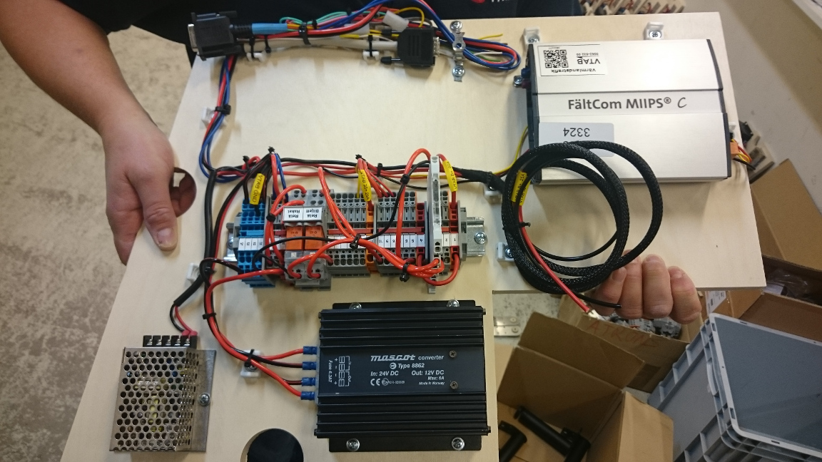
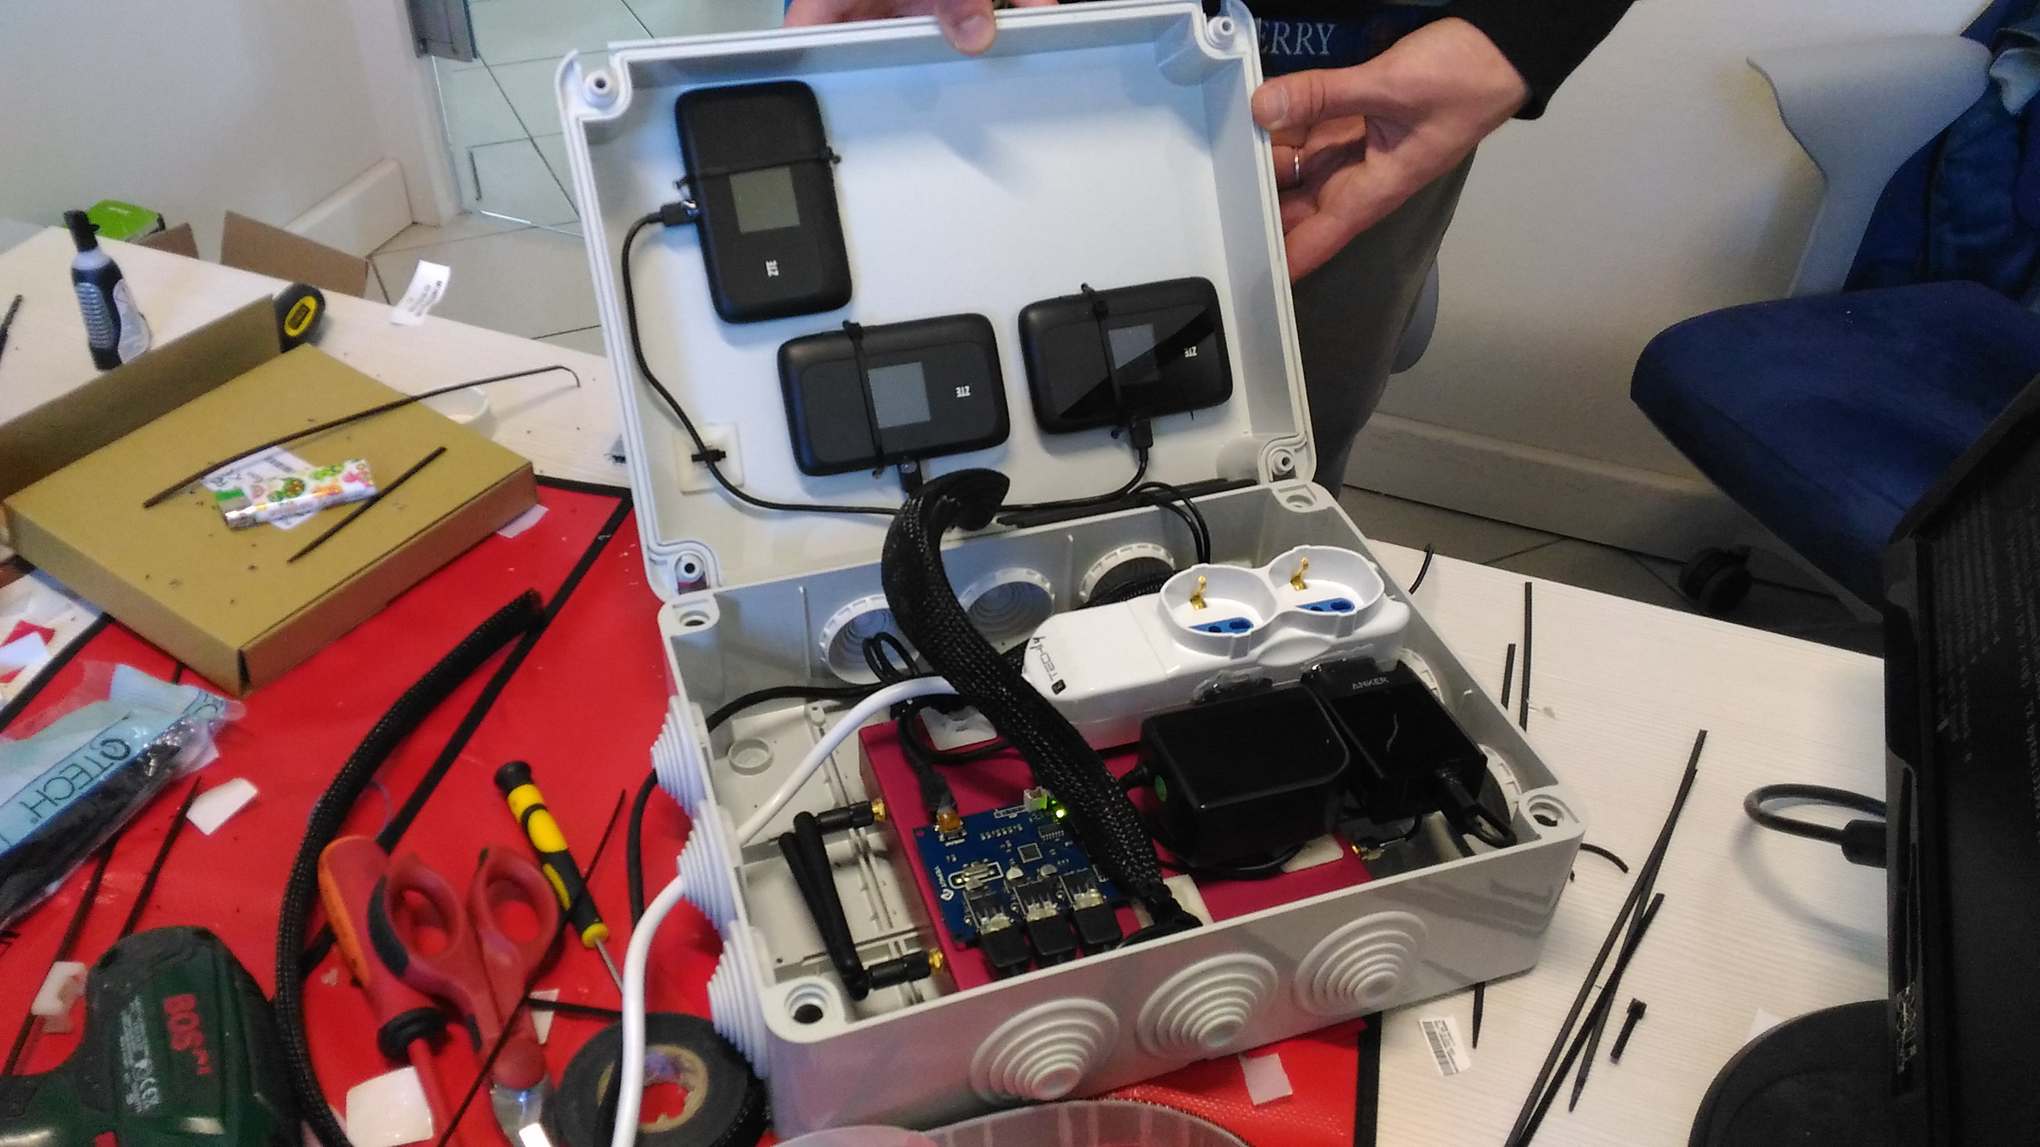
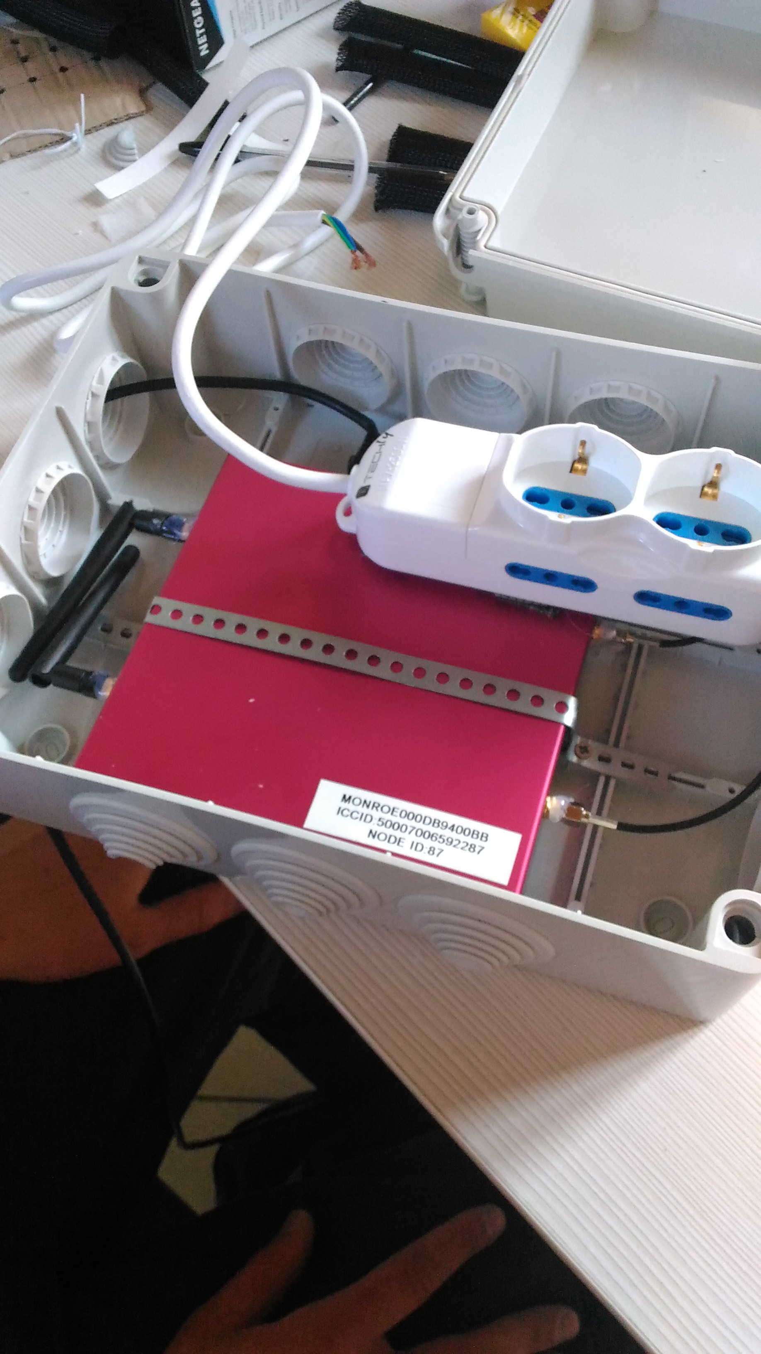
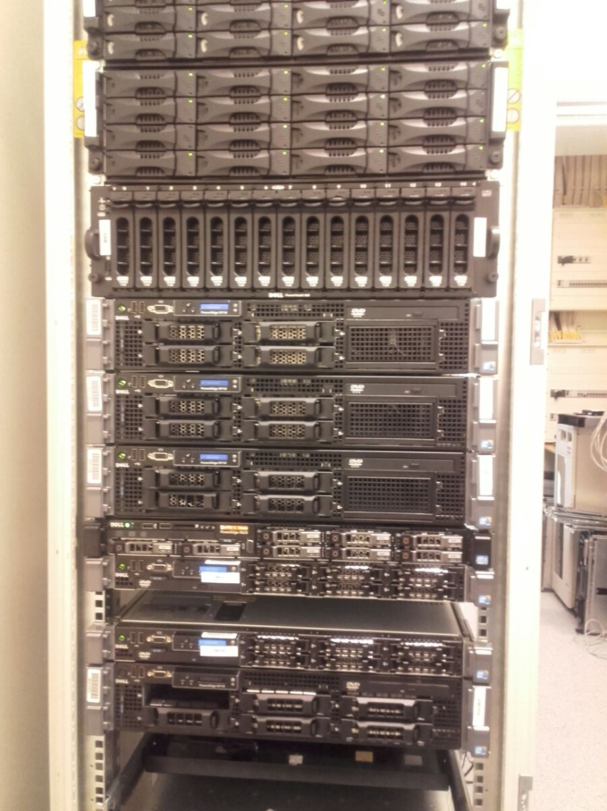
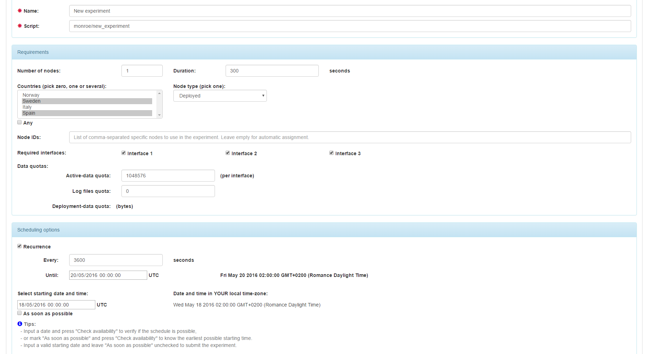
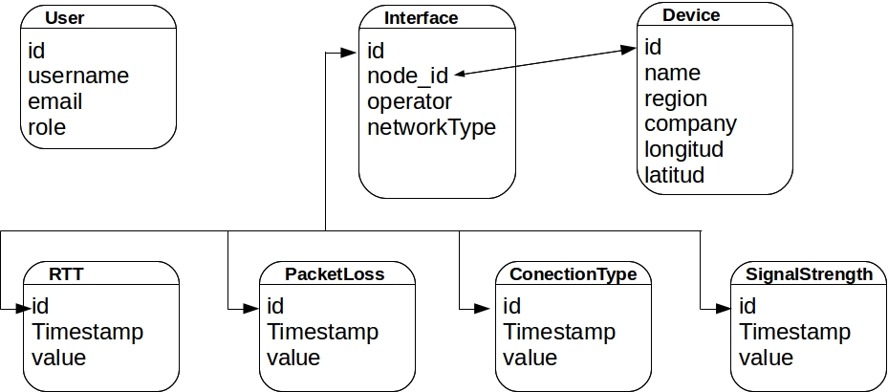
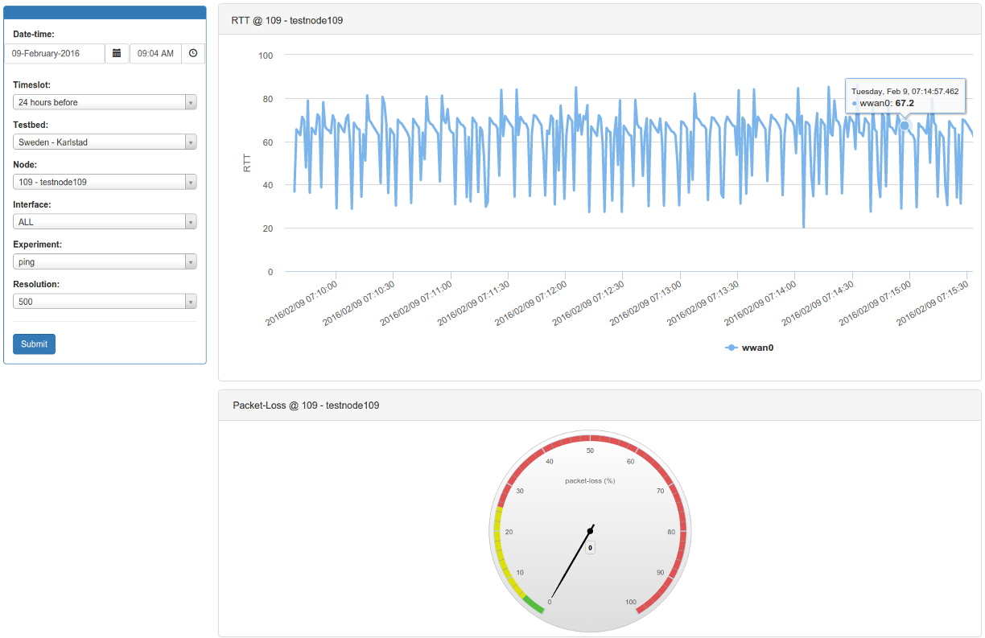
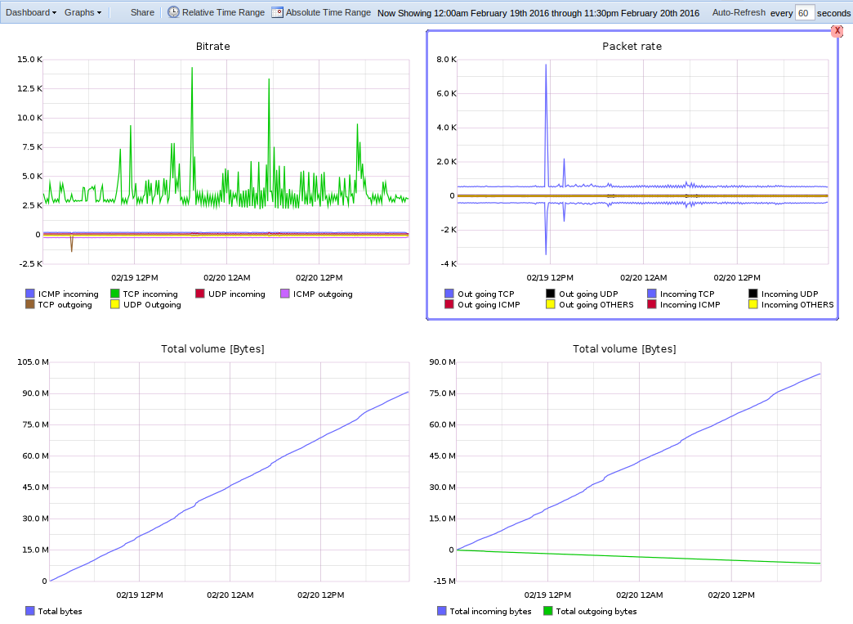
Prototype platform
Working prototype
Nodes
Servers
Scheduler/user access
Databases
Visualization
Currently used
Several nodes deployed
Mobile and static
Running experiments
Collecting measurements

Slide 5
MONROE NODE

Slide 6
Closer look into the MONROE node
NODE
Network Monitor
Core
Components
Watchdog
Routing
Device Listener
METADATA Multicast
ZeroMQ
EXPERIMENTS (Docker containers)
CONTAINER 1
CONTAINER 2
CONTAINER 3
CONTAINER 4
CONTAINER X
All continuous, MONROE measurements
(PING, etc…)
All periodic, BW intensive, MONROE measurements
(HTTP, video, etc…)
ALL METADATA to be exported to the DB
TSTAT
EaaS
mPlane
External User’s
Experiments
MONROE Experiments

Slide 7
Node: Experiments
EXPERIMENTS
CONTAINER 1
CONTAINER 2
CONTAINER 3
CONTAINER 4
CONTAINER X
All continuous, MONROE measurements
(PING, etc…)
All periodic, BW intensive, MONROE measurements
(HTTP, video, etc…)
Experiment as a Service
User experiments
ALL METADATA
TSTAT
MONROE Experiments
mPlane
External User’s Experiments
A container, when running,
has direct access to all network interfaces, routing configured by core
has read/write access to its own file system, overlaid upon the file system we provide
Software can be available on the node, or installed in the overlay
Experimenters provide an image of the overlays (stores changes to base system only)
Containers 1, 3 and 4 run continuously
Containers 2, X are scheduled, only one runs at a time for active measurements

Slide 8
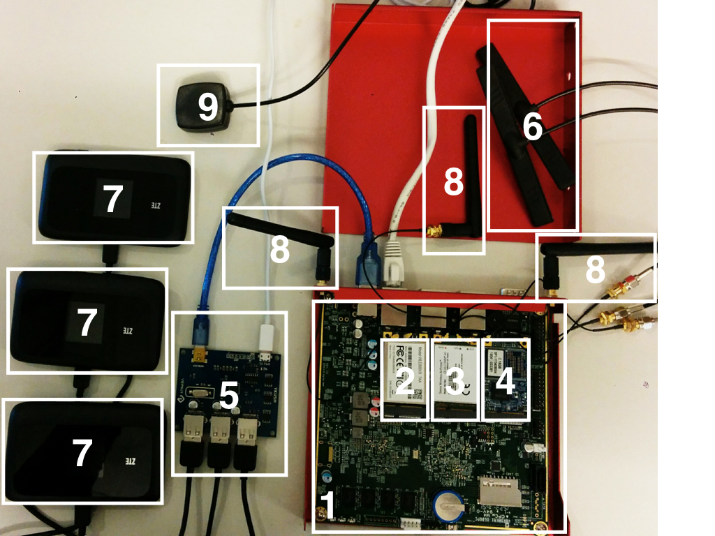
Hardware Design
Requirements:
Linux support
MBB and WiFi connectivity
Processing power and Data storage
Minimize external interventions
Hardware cost
Availability

Slide 9
Bill of Materials
Component | Description | Type of Node | Block
APU1D4 system board | 1 GHz CPU dual core 64 bits 4 GB DRAM 3 GB Ethernet ports 2 USB 2.0 ports | Stationary & Mobile | 1
Compex WLE600VX | 802.11ac/b/g/n Dual-Band mPCIe module | Stationary & Mobile | 2
Sierra Wireless MC7304 | LTE mPCIe module | Stationary & Mobile | 3
SSD M-Sata | 16GB | Stationary & Mobile | 4
Yepkit YKUSH | powered USB hub | Stationary & Mobile | 5
ZTE MF910 | Modem WiFi (3) | Stationary & Mobile | 7
Antennas | LTE (2), WIFI (2) and GPS | Stationary & Mobile | 6, 8, 9
Accessories | cables, AC adapter, box, etc. | Stationary & Mobile | -
GSM socket Walf Guard |  | Stationary | -
Converters | [24,48,110 V] - 12 V (APU) [24,48,110 V] - 5 V (USB hub) | Mobile | -

Slide 10
Subscriptions
Country | Operators
Italy | TIM, Wind and Vodafone
Spain | Orange, Yoigo and Vodafone
Sweden | 3, Telia and Telenor
Norway | Telenor, Telia and ICE

Slide 11
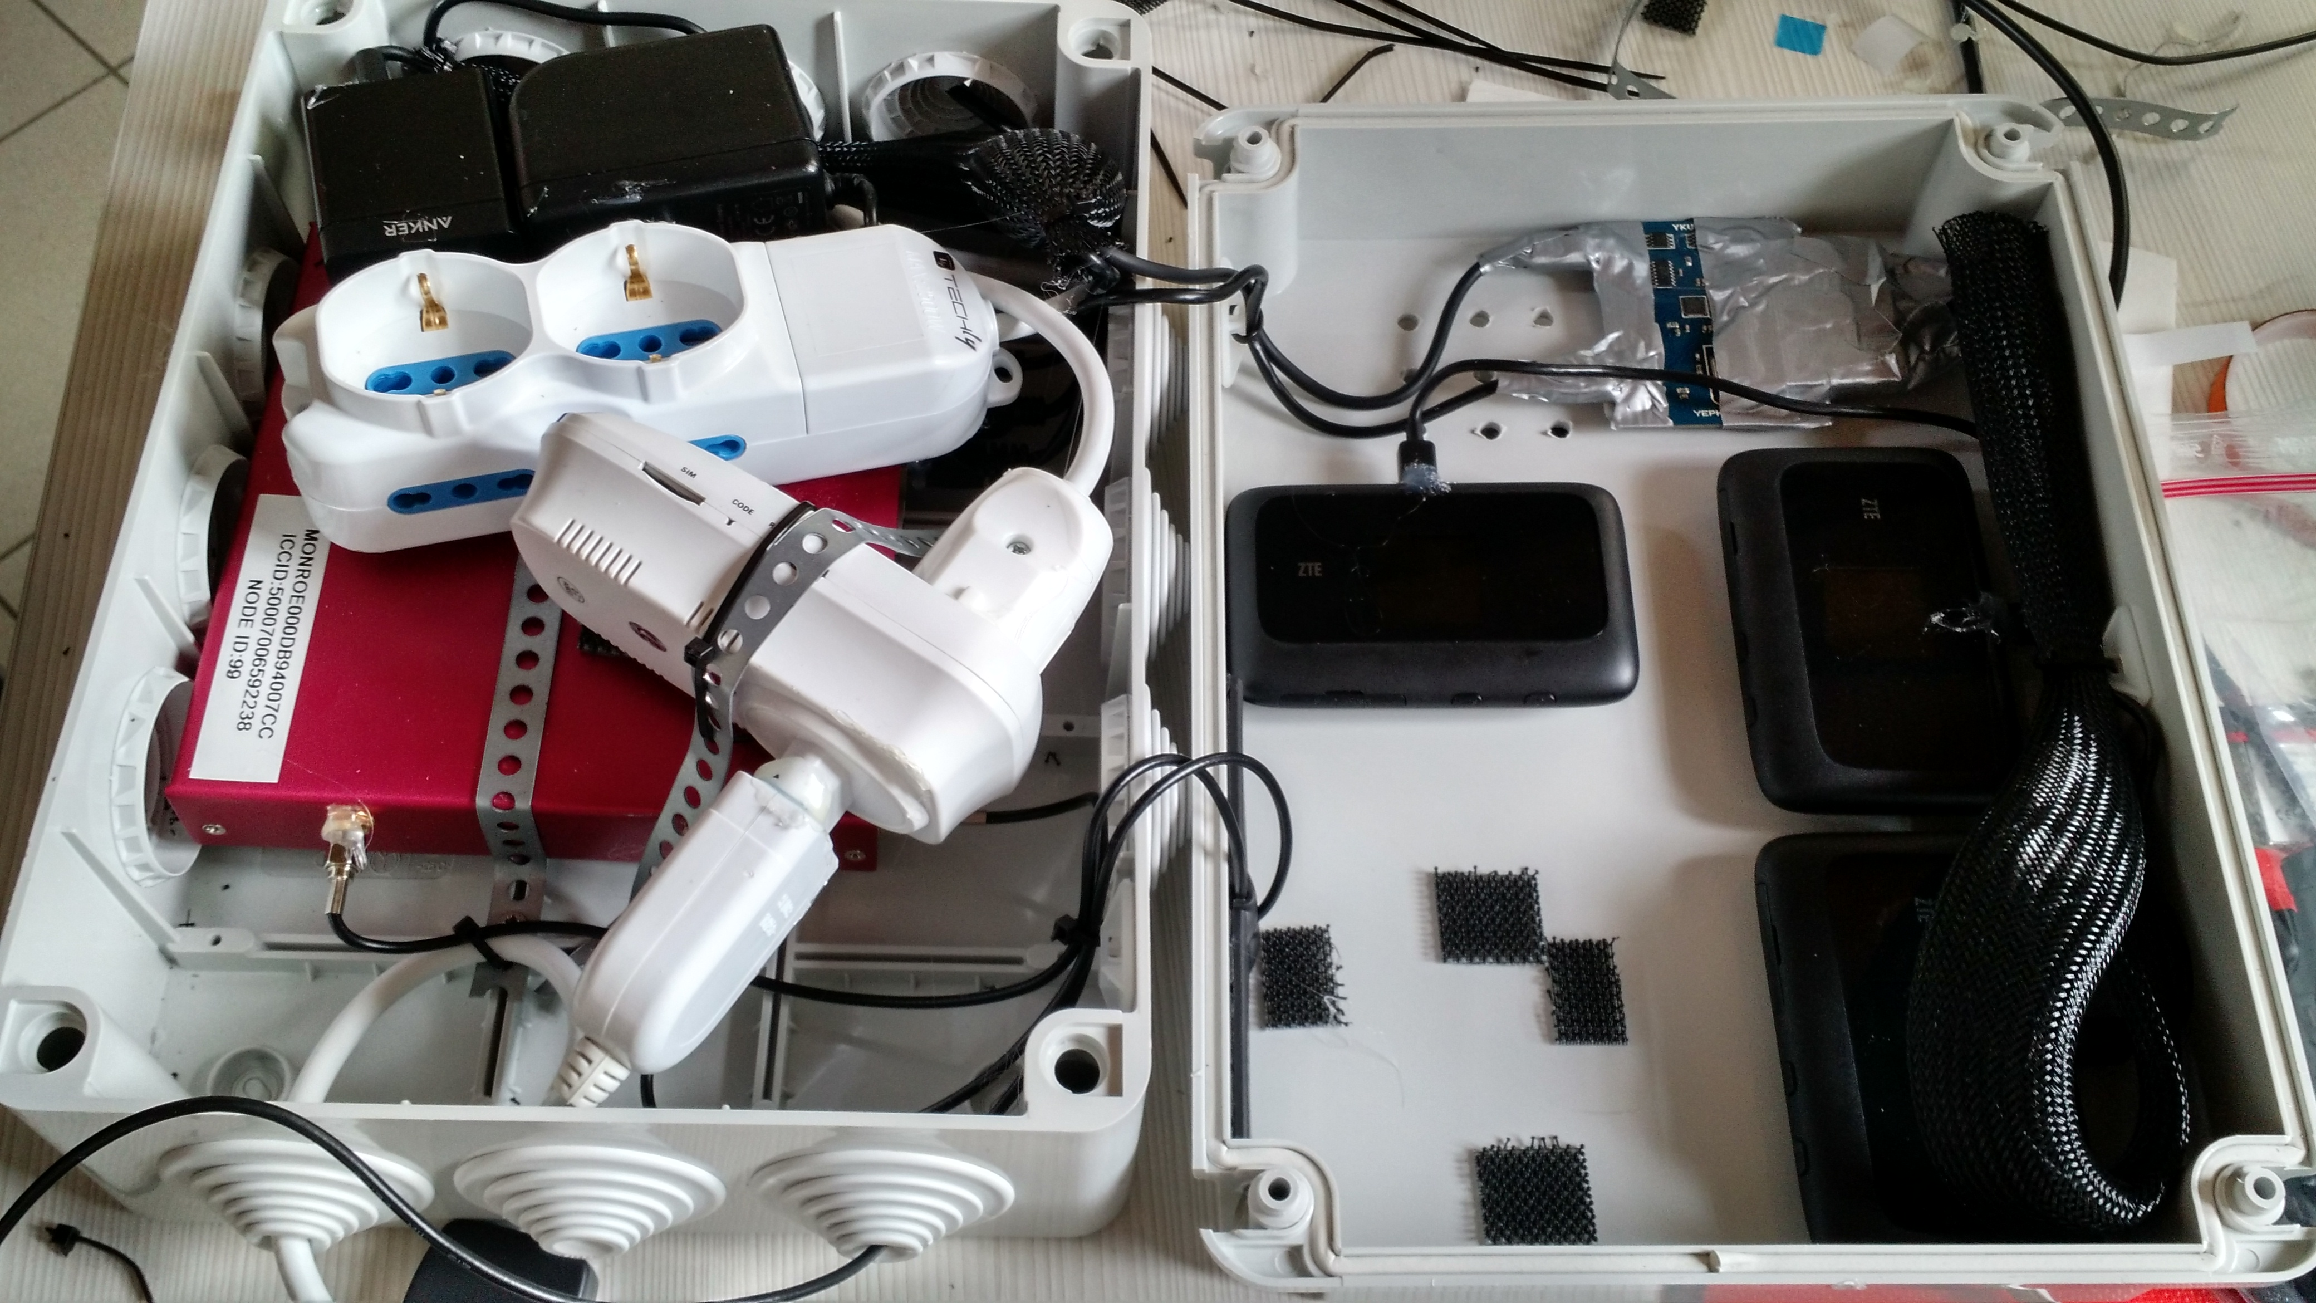
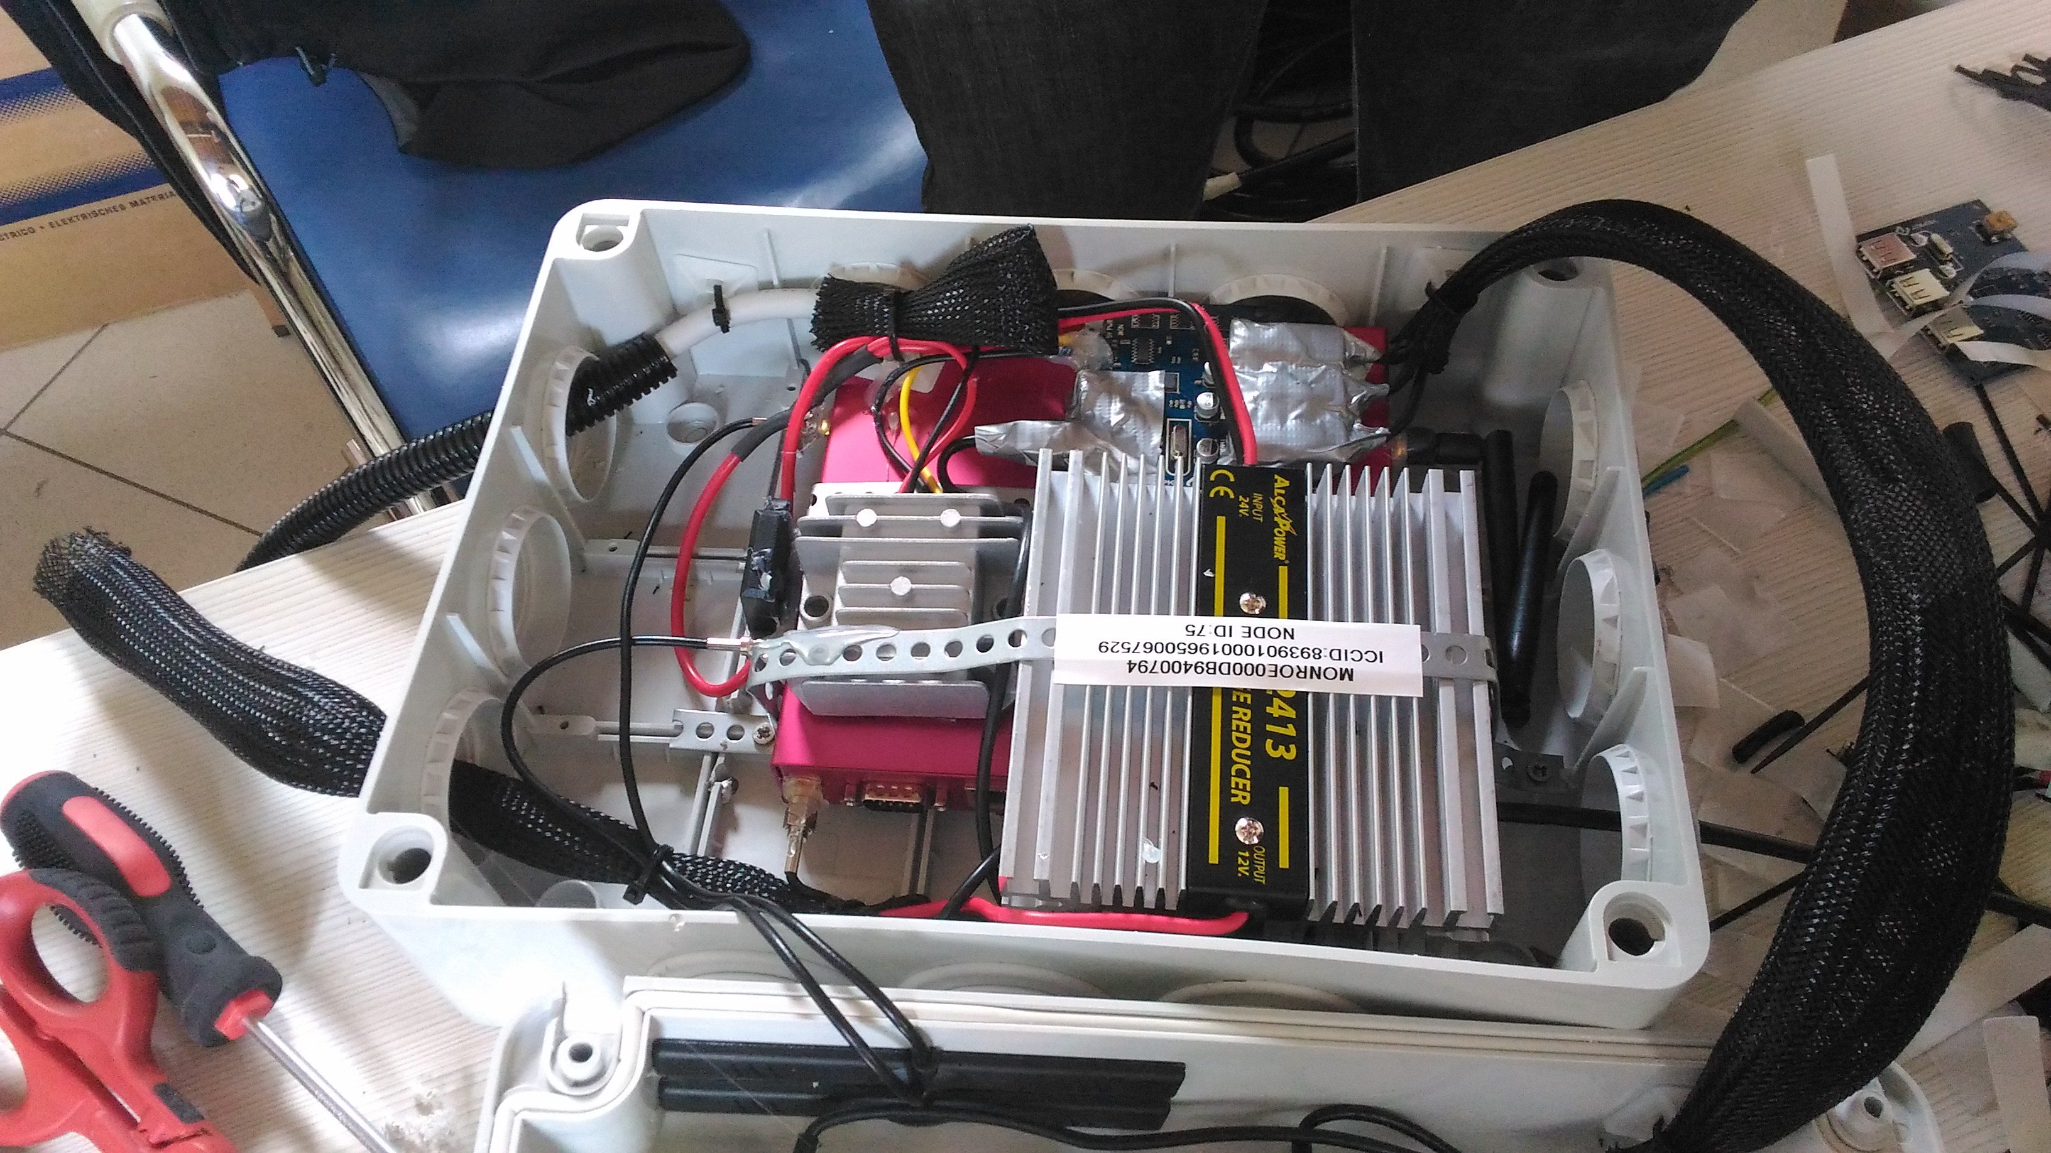
MONROE Nodes
Stationary nodes
Mobile nodes

Slide 12
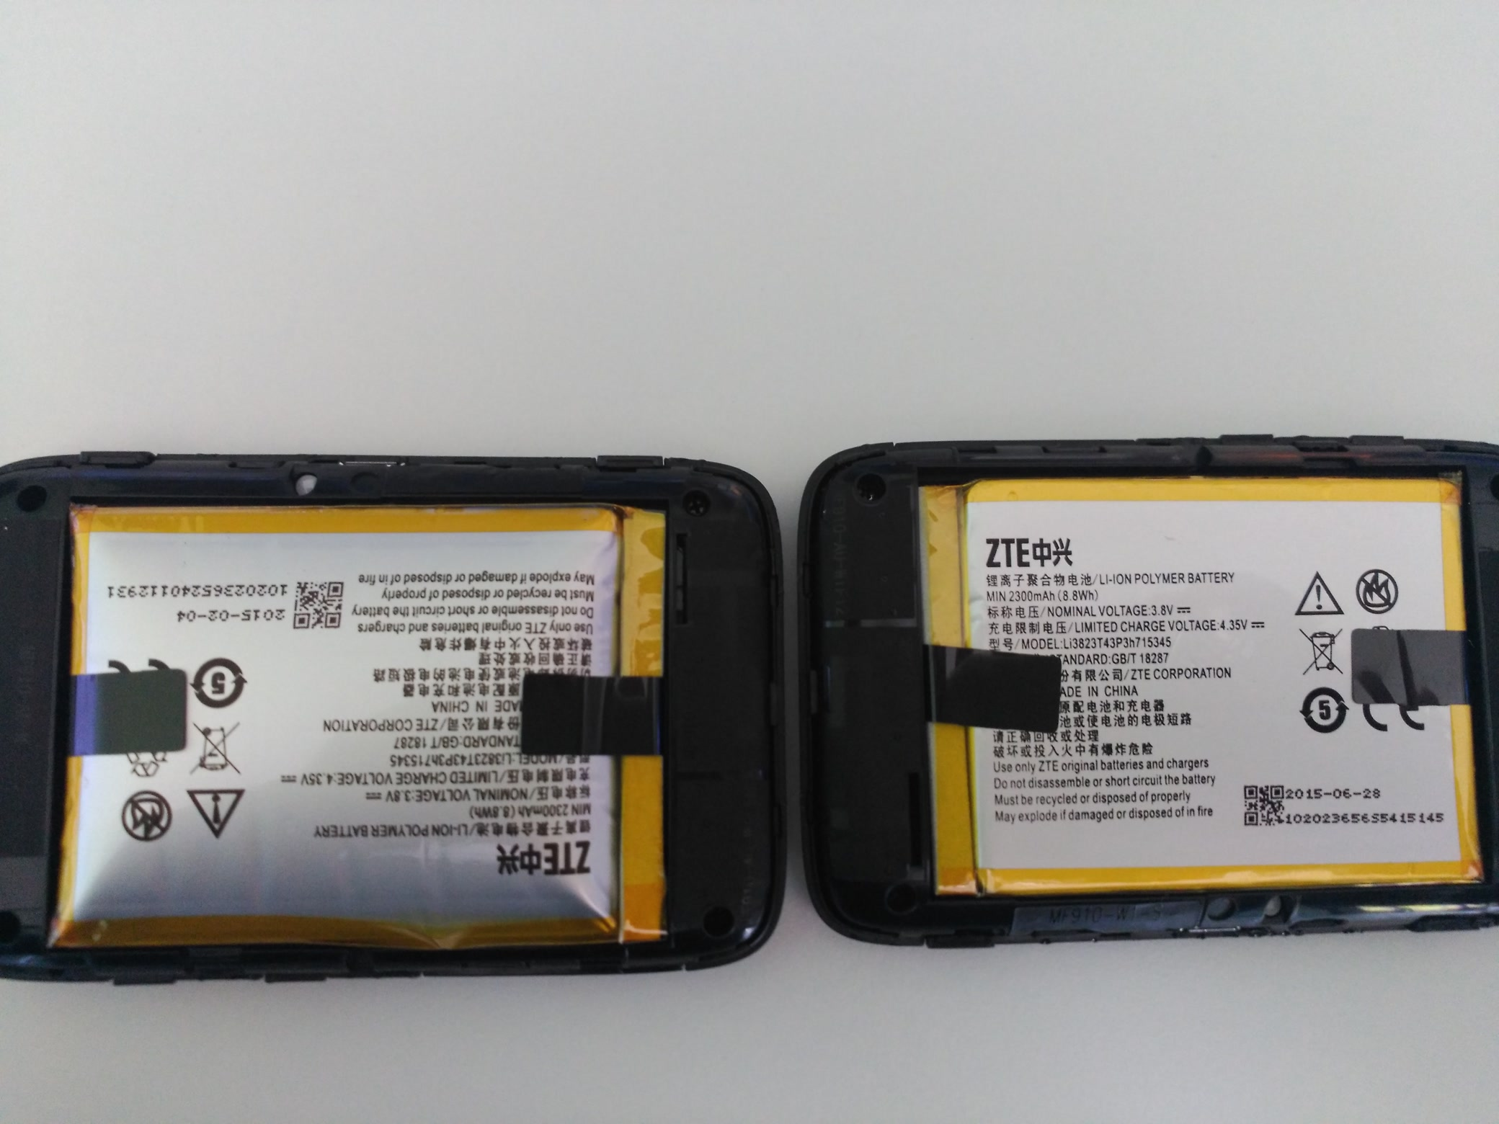
MONROE NODES – battery issues

Slide 13
MONROE Nodes – Current Issues
We observed that the batteries of some of the ZTE MiFis were bloated – power management issues in the yepkit hub
Assessing new design solutions
APU1 (Internal Modem + WiFi) + APU2 (2 internal modems) system
Two standalone APUs measuring three MBB providers

Slide 14
MONROE Nodes – Current Issues
Deployment stalled and we will be delaying opening the platform (5 months extension)
Within MAMI – coordination with MONROE to run experiments on current nodes

Slide 15
Revelio Update

Slide 16
Revelio Update
Resubmission to TMA – measurements in FCC MBA and RIPE
CGN characterization – external users of MONROE

Slide 17
Q&A

